Slide 1
Home reading №2
Prepared by Norkin Mark

Slide 2
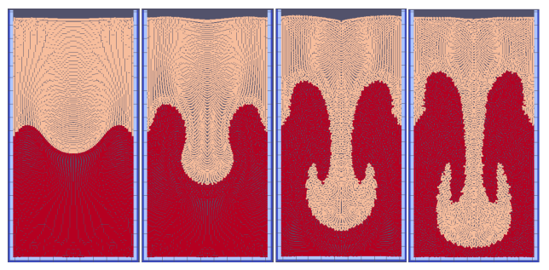
Definition of terms
Rayleigh-Taylor instability test - a classical test case for the flow of two fluids of different densities. A sinusoidal interface separates the two fluids. The heavier fluid is on top.
The Atwood number - The Atwood number is a dimensionless number in fluid dynamics. The difference in the fluid densities divided by their sum
kinematic viscosity - Kinematic viscosity is the ratio of dynamic viscosity to the density of a liquid (gas).
dynamic viscosity - The internal friction of liquids, as well as gases, occurs when a liquid moves due to the transfer of momentum in a direction perpendicular to the direction of motion.
The moving particle semi-implicit (MPS) method is a computational method for the simulation of incompressible free surface flows.

Slide 3
Questions
What classic tests were carried out to check the correctness of the program?
How do you think, does this model capable of simulating the behavior of a weakly compressible fluid?
Could you tell me what strategy is used in this study for neighbourhood search?
What the cell-linked method relies on?
Do you know why the cell-linked method gives a performance boost?
Can user interaction take place through a graphical interface?
What simulation parameters can the user choose?
Do you know what parameter the simulation of the destruction of a water column is used to estimate?
What is the purpose of the Rayleigh-Taylor instability test?
Do you think switching between weakly compressible (WC) or fully incompressible (FI) fluids affects performance and memory costs?
What methods of computing load distribution are available in this work?
It is more profitable to simulate a small number of particles using a GPU or using sequential execution in a central processor?

Slide 4
Abstract
In this paper, the MPS method and methods for its improvement are considered. The physical model used in the program and the assumptions made by the author were described. The problem of multi-density fluids interaction has been solved by introducing the density function. The prospects for the development of this method and the scope of its application were described. A series of experiments were conducted that showed better performance and accuracy.

Slide 5
Summary
Andre Luis Buarque Vieira and Silva in the ”fluid modeling system based on the MPS method" claim that he has developed a numerically stable and parallelized version of the MPS method. According to the author, this method can simulate liquids using various approaches, such as two methods for calculating particle pressure, turbulent flow and multiphase interaction. In addition, the method is evaluated within the framework of traditional tests that give comparable results with the latest methods.
The author begins by indicating the scope of this program: solving engineering problems related to natural and environmental disasters in coastal and flooded areas, such as dam breaks, flood modeling, oil spills, and others. This method allows us to stimulate these phenomena with greater accuracy and less time by using parallelization and some numerical improvements.. Next, the author describes the selected physical models, the standard method of semi-implicit particles and what problems there are in it and what improvements have been made to it. For example, the fluid in this paper is considered incompressible, and numerical improvements have been made to the Laplacian of pressure and viscous forces. Moreover, the author notes that the method of semi-implicit particles does not allow modeling the interaction of two liquids with different densities due to problems with boundary conditions, but in this paper this problem is solved. In conclusion, the author describes the types of simulations performed, analyzes and compares the data obtained. As the researchers expected, the results were comparable to the results of other programs, and the speed of problem solving was about five times higher.

